Slide 1
Recommendation system survey
Hanyu Li

Slide 2
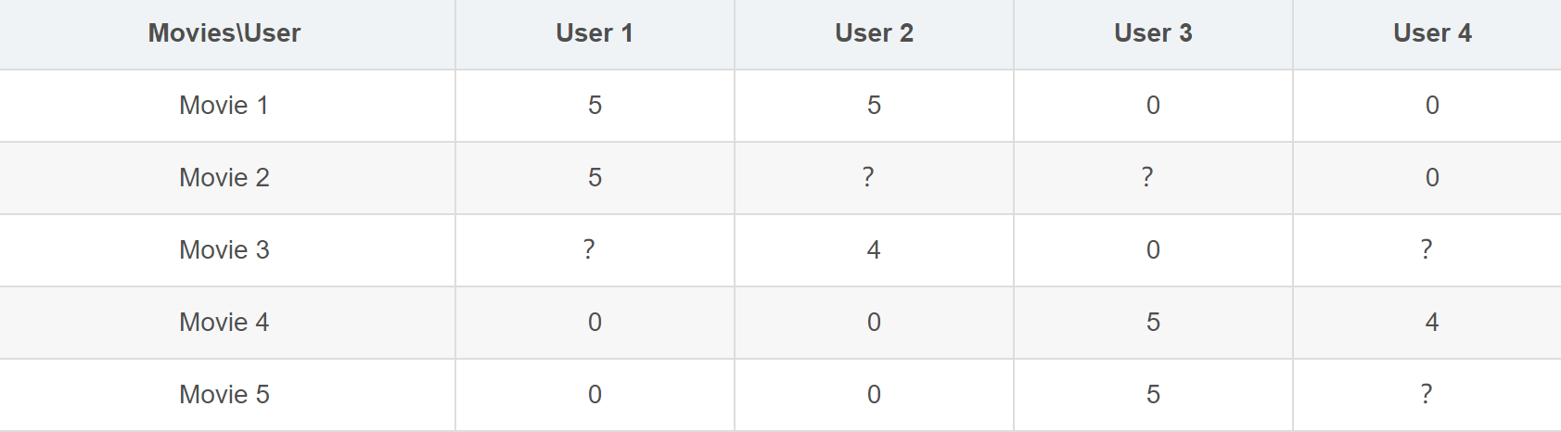
Main concern: Fill in the user-item matrix

Slide 3
Some Concepts
User&Item matrix
Rating prediction: fill the missing entries of the user-item rating matrix
Top-n recommendation: provide ranked list with n items to users
Classification task: classify the candidate items into categories
Complicit/Implicit feedback: user’s previous ratings/browsing histories
Collaborative filtering: makes recommendations by learning from user-item historical interactions, either explicit or implicit feedback
Content-based: based on comparisons across items’ and users’ auxiliary information
Latent vector
Negative sampling: sample a small subset from the negative set (items with which the user has not interacted)

Slide 4
Traditional methods
Including:
Content-based;
User-CF;
Item-CF;
Model-CF: MF, BPR, FM

Slide 5
Content-based
Try to figure out:
What users like
From the history
What items are
From heuristic methods or tagging
For example:
Extract feature from items
use the mean of user history to represent the interest of this user
Do cosine similarity to find an unexplored item for the user

Slide 6
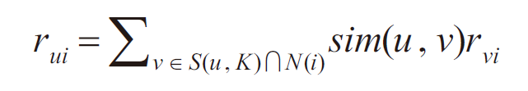
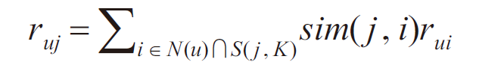
Collaborative filtering
User-CF
Item-CF
Average rating of the same items/users from similar users/items that is not empty

Slide 7
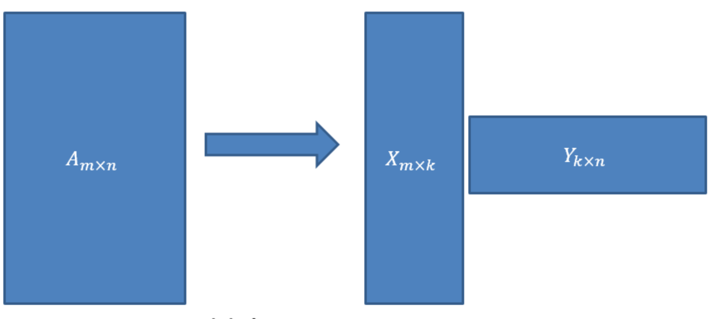
Collaborative filtering Model-based CF
MF(using SVD)
Matrix Factorization
k is latent vector dimension
One row in X corresponds to The description of a user using k dimension vector
Use gradient descent to fit X and Y(with ground truth of A)

Slide 8
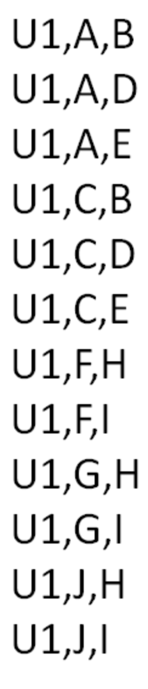
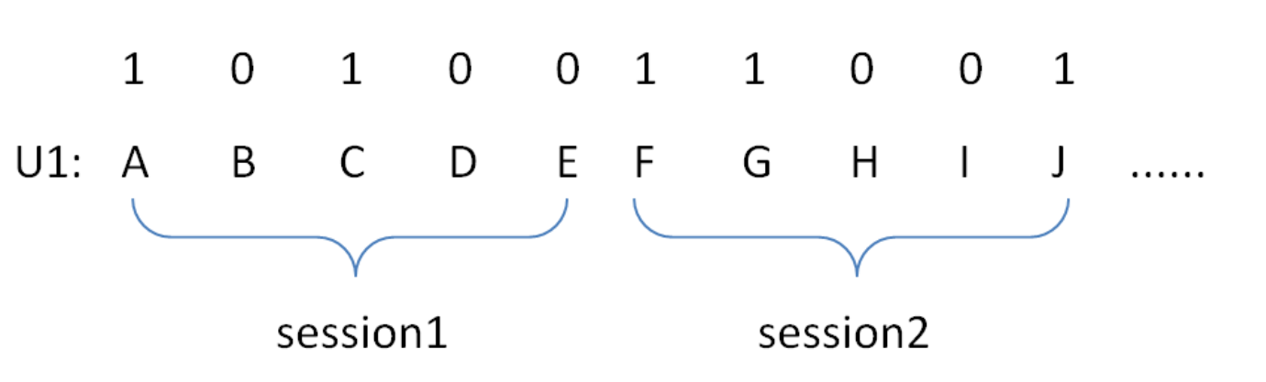
Collaborative filtering Model-based CF
BPR
Bayesian Personalized Ranking
Triplet: (u,i_1,i_2)-> in ground truth u like i_1 more than i_2
Maximize likelihood of all triplets adjusting MF parameters
No need to assume all unknown items are disliked by users

Slide 9
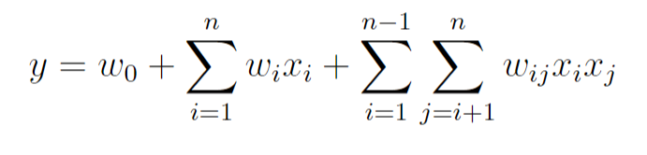
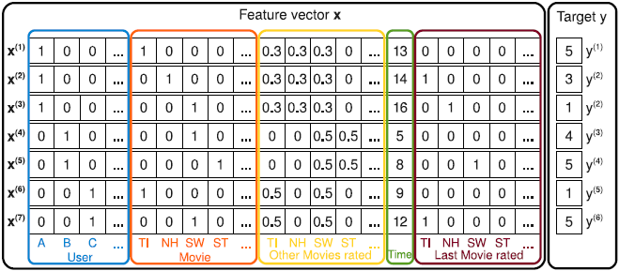
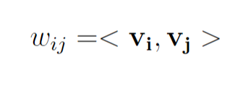
Collaborative filtering Model-based CF
FM
Factorization Machine
One latent vector for each sparse feature, thus do not need to optimize every pair seperately

Slide 10
DL-involved methods
Main reference:
Shuai Zhang, Lina Yao, and Aixin Sun. 2017.
Deep Learning based Recommender System: A Survey and New Perspectives.

Slide 11
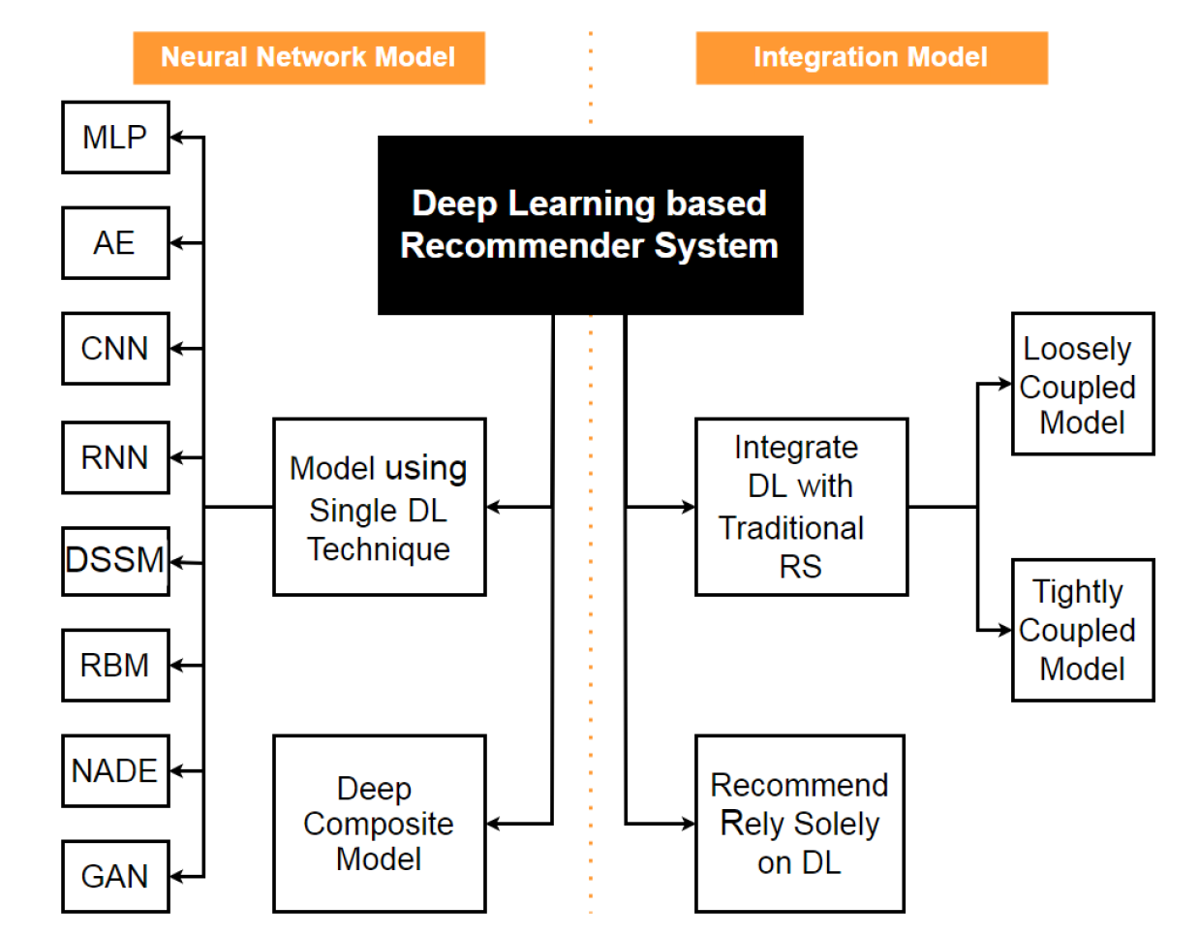
Summary
feature extraction
nonlinear correlation

Slide 12
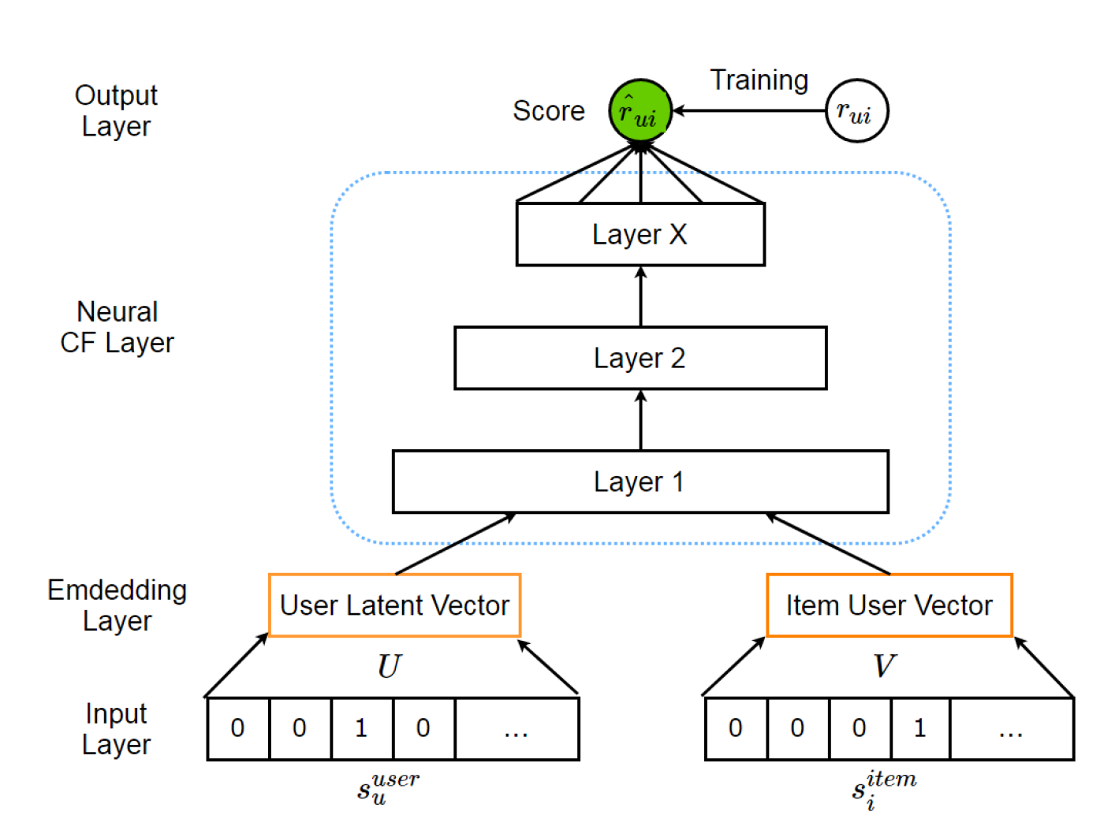
NCF(Neural Collaborative Filtering) Using MLP Solely DL
Generalization of MF:
MLP instead of simple inner product of latent vectors
MSE loss
Negative sampling

Slide 13
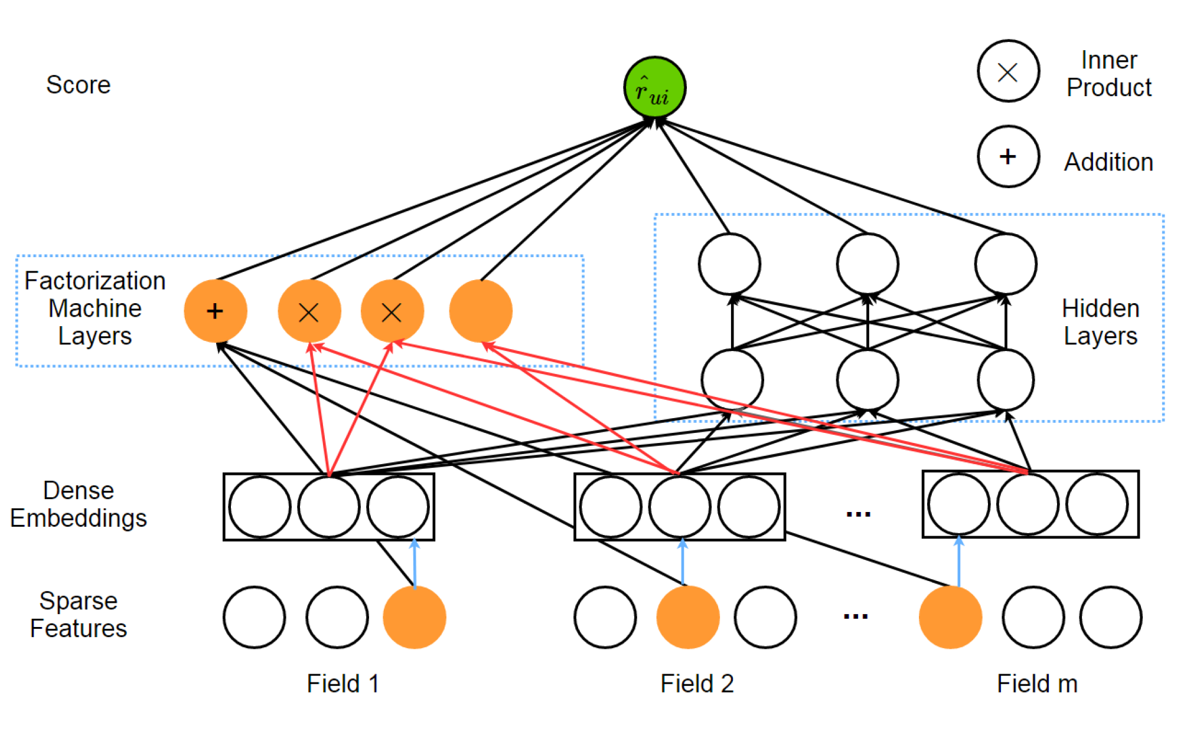
DeepMF(Deep Matrix Factorization) Using MLP Solely DL
Combining(simple addition) with MLP
Each field will be represented by the V_i that belongs to the 1 in one-hot vector
Turing the size of a field to k
Latent vector(V_i) from different fields concatenated together

Slide 14
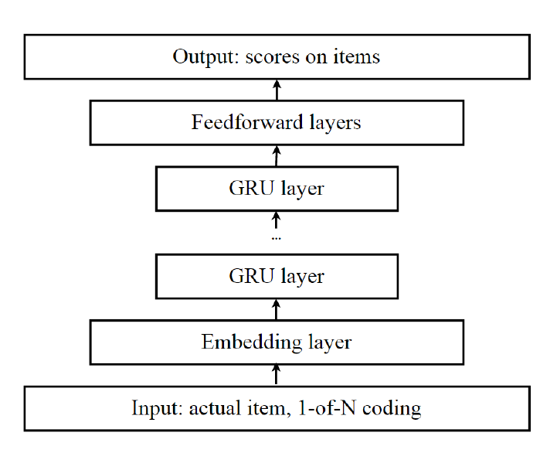
Session-based Recommendation with RNN Using RNN Solely DL
Comparatively smaller data from all history to cookie or session
Input the previous session and output the probability of appearance of every item in the upcoming session

Slide 15
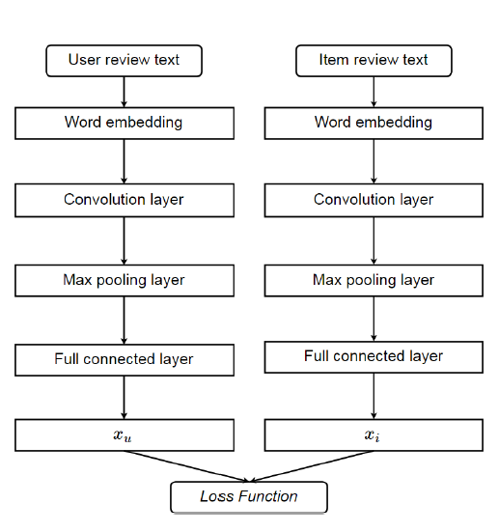
DeepcoNN(Deep Cooperative Neural Network) Using CNN Tightly coupled with FM
Simply use CNN to extract text feature
Feed the extracted feature of user and item into FM
Transnet modified this network so that it will not rely heavily on the review from desired user to desired item

